Slide 1
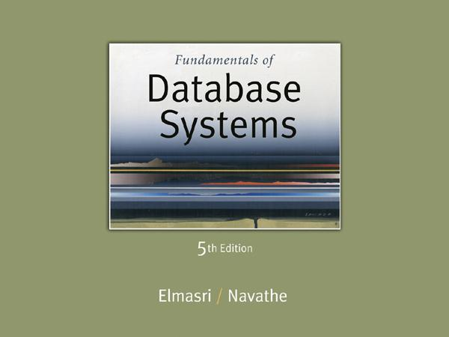

Slide 2
Query Optimization
An SQL Query-> converted to a Relational Algebra expression trees
Initial RA expression is rewritten
Using Heuristics and Algebraic Transformation Rules that preserve the meaning of the expression
Final RA expression tree is generated
Cost based query Optimization
Cost estimates of methods, for RA operations are computed
Execution plan with the least estimated cost is chosen

Slide 3
7. Using Heuristics in Query Optimization(1)
Process for heuristics optimization
The parser of a high-level query generates an initial internal representation;
Apply heuristics rules to optimize the internal representation.
A query execution plan is generated to execute groups of operations based on the access paths available on the files involved in the query.
The main heuristic is to apply first the operations that reduce the size of intermediate results.
E.g., Apply SELECT and PROJECT operations before applying the JOIN or other binary operations.

Slide 4
Using Heuristics in Query Optimization (2)
Query tree:
A tree data structure that corresponds to a relational algebra expression. It represents the input relations of the query as leaf nodes of the tree, and represents the relational algebra operations as internal nodes.
An execution of the query tree consists of executing an internal node operation whenever its operands are available and then replacing that internal node by the relation that results from executing the operation.
Query graph:
A graph data structure that corresponds to a relational calculus expression. It does not indicate an order on which operations to perform first. There is only a single graph corresponding to each query.

Slide 5
Using Heuristics in Query Optimization (3)
Example:
For every project located in ‘Stafford’, retrieve the project number, the controlling department number and the department manager’s last name, address and birthdate.
Relation algebra:
πPNUMBER, DNUM, LNAME, ADDRESS, BDATE (((σ_{PLOCATION=‘STAFFORD’}(PROJECT))
_{DNUM=DNUMBER} (DEPARTMENT)) _{MGRSSN=SSN} (EMPLOYEE))
SQL query:
Q2: SELECT P.NUMBER,P.DNUM,E.LNAME, E.ADDRESS, E.BDATE
FROM PROJECT AS P,DEPARTMENT AS D, EMPLOYEE AS E
WHERE P.DNUM=D.DNUMBER AND D.MGRSSN=E.SSN AND P.PLOCATION=‘STAFFORD’;

Slide 6
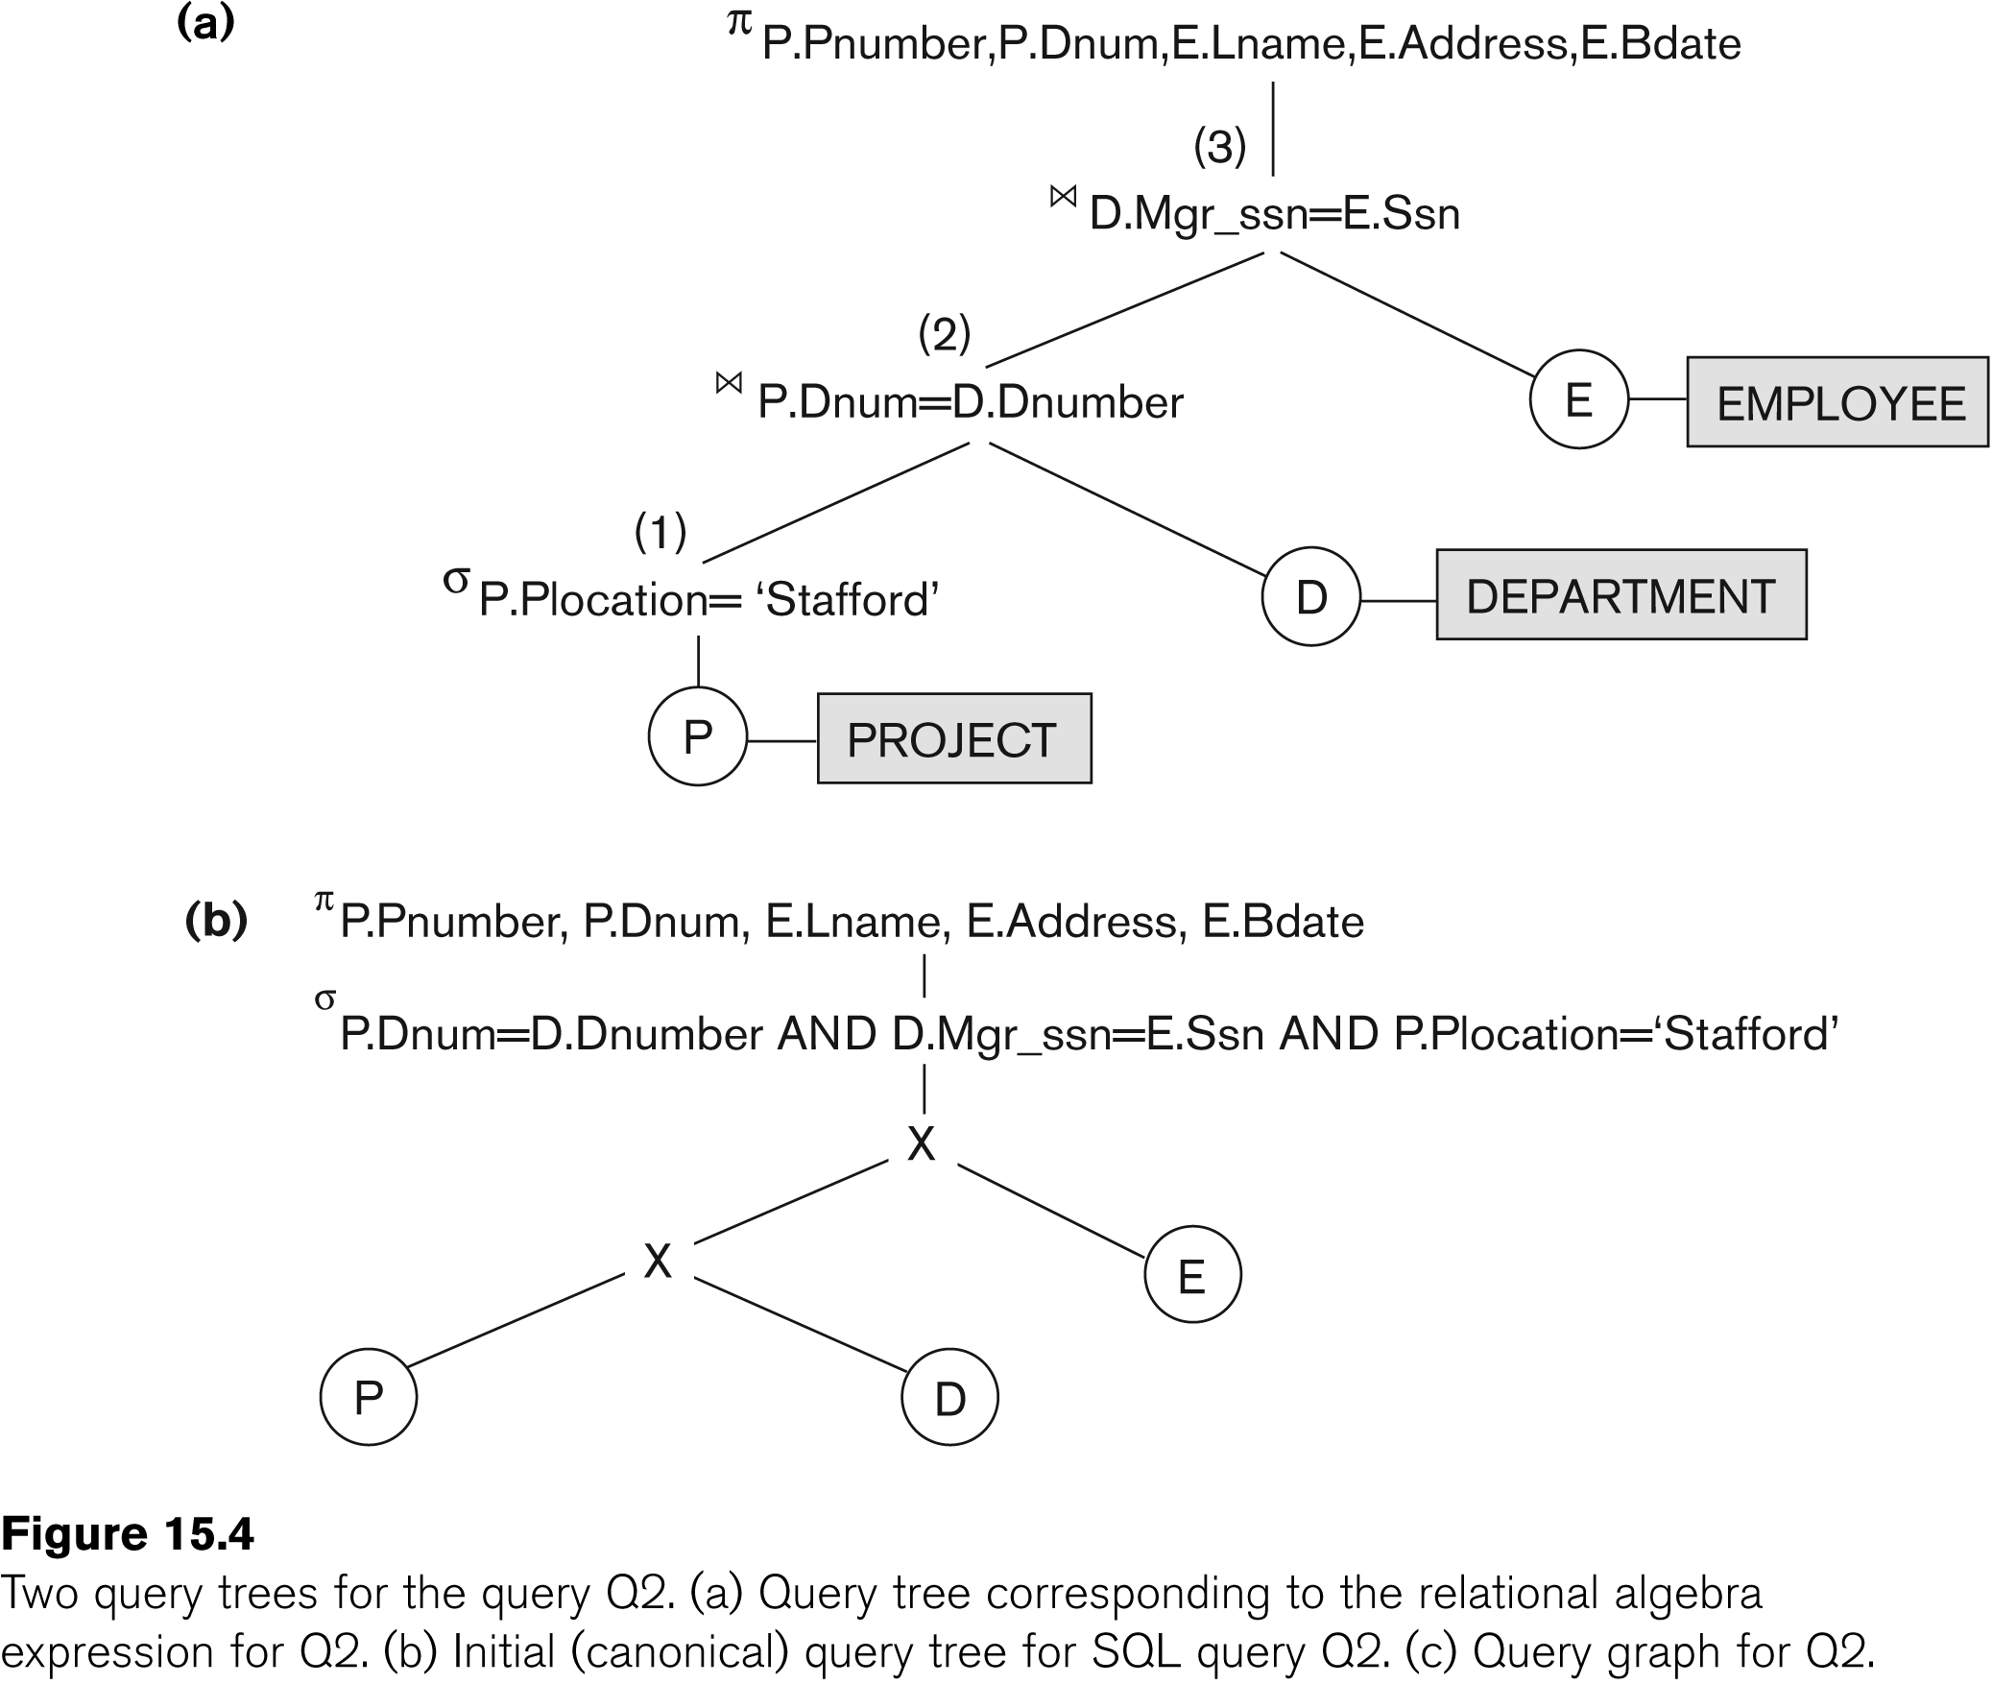
Using Heuristics in Query Optimization (4)

Slide 7
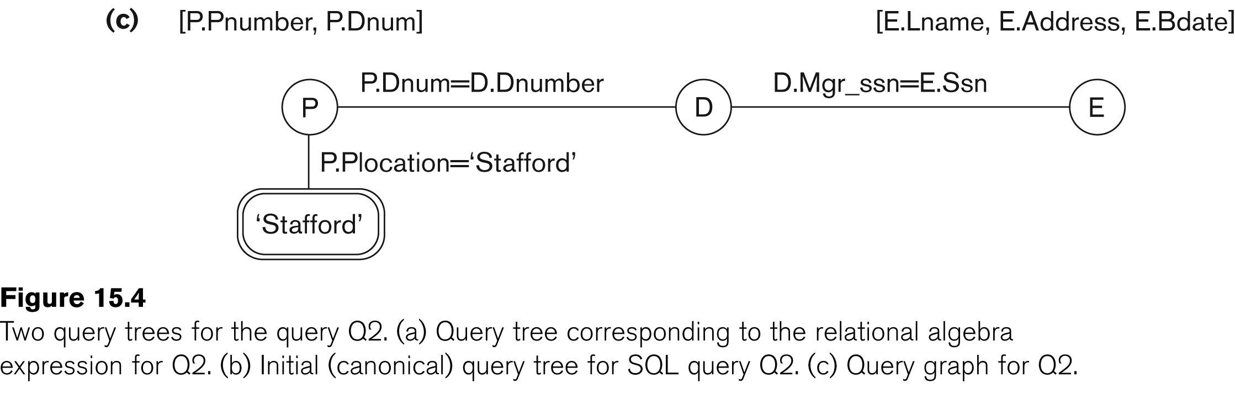
Using Heuristics in Query Optimization (5)

Slide 8
Using Heuristics in Query Optimization (6)
Heuristic Optimization of Query Trees:
The same query could correspond to many different relational algebra expressions — and hence many different query trees.
The task of heuristic optimization of query trees is to find a final query tree that is efficient to execute.
Example:
Q: SELECT LNAME
FROM EMPLOYEE, WORKS_ON, PROJECT
WHERE PNAME = ‘AQUARIUS’ AND PNMUBER=PNO AND ESSN=SSN AND BDATE > ‘1957-12-31’;

Slide 9
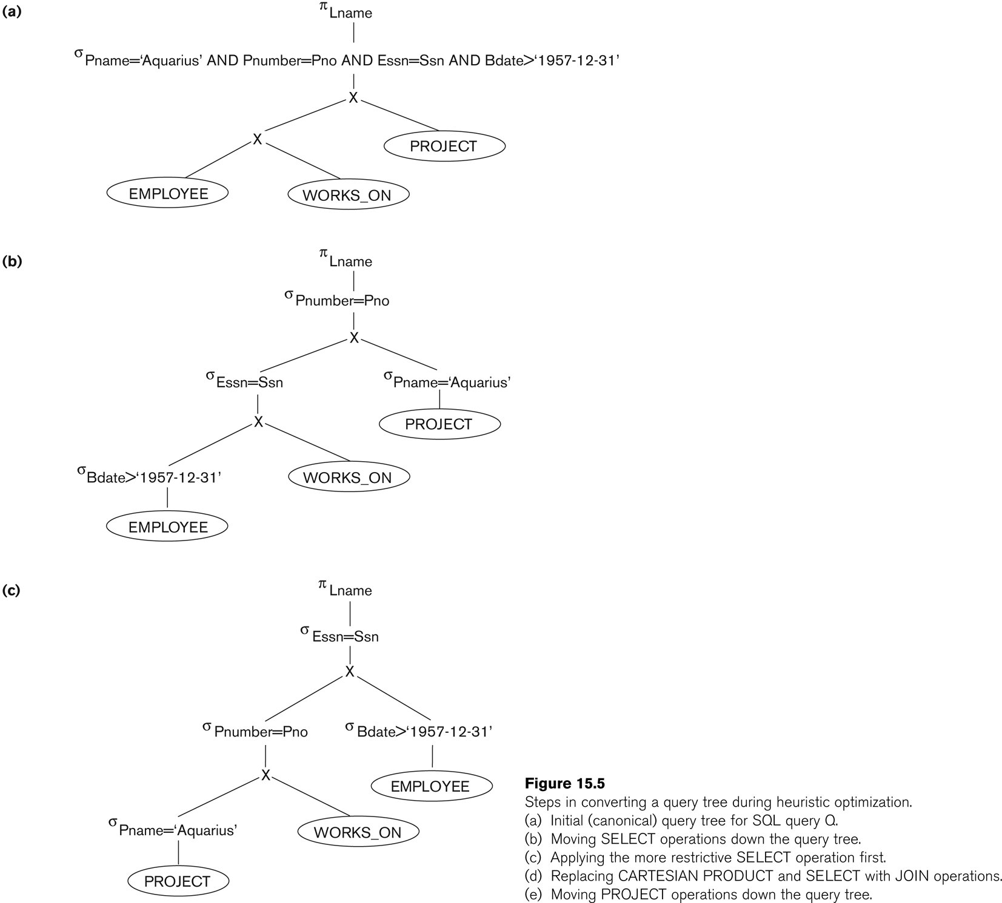

Slide 10
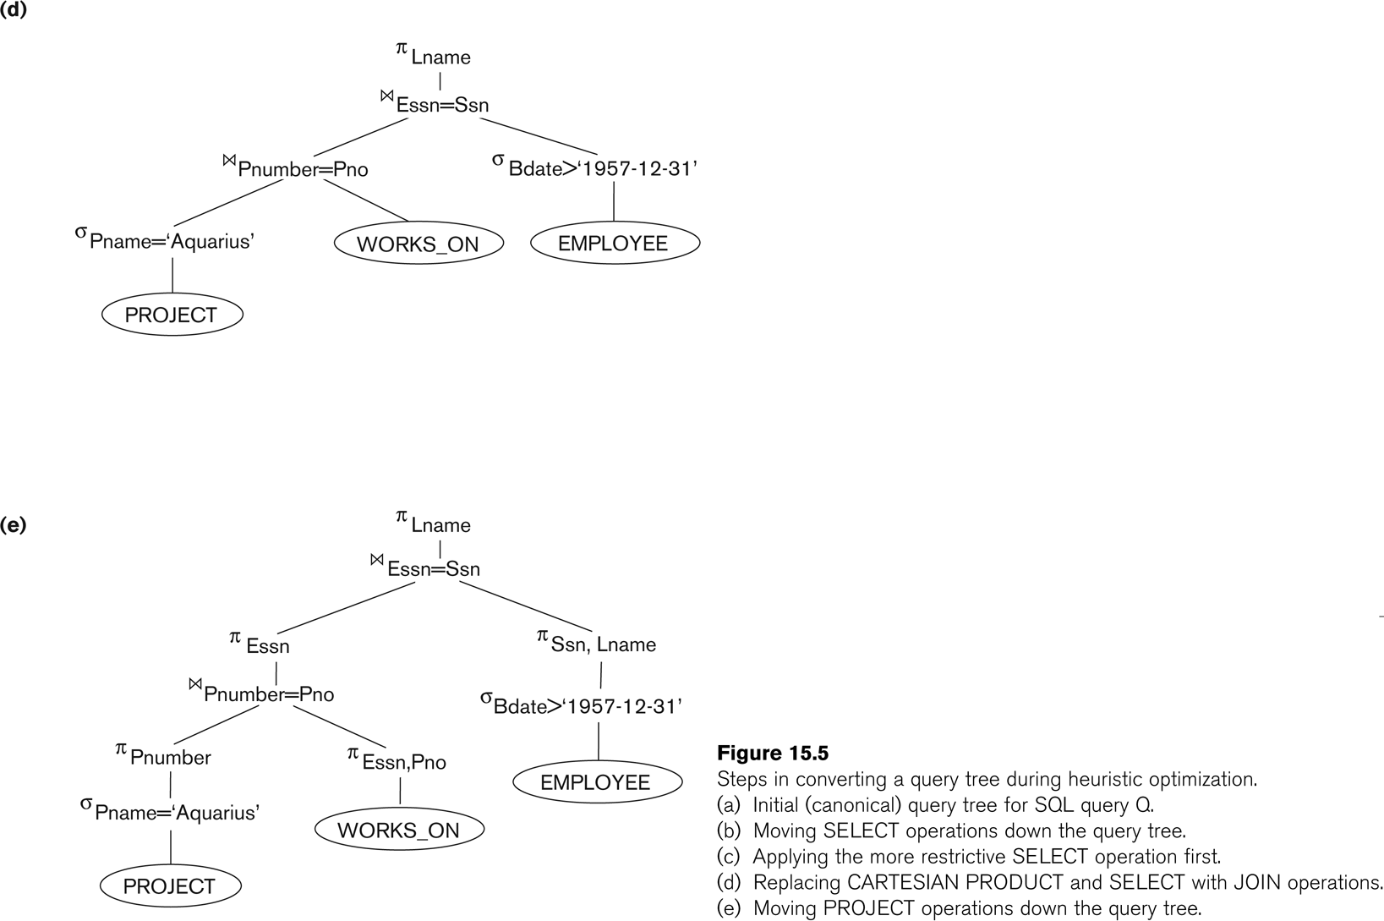

Slide 11
Using Heuristics in Query Optimization (9)
General Transformation Rules for Relational Algebra Operations:
1. Cascade of σ: A conjunctive selection condition can be broken up into a cascade (sequence) of individual σ operations:
σ _{c1 AND c2 AND ... AND cn}(R) = σ_{c1} (σ_{c2} (...(σ_{cn}(R))...) )
2. Commutativity of σ: The σ operation is commutative:
σ_{c1} (σ_{c2}(R)) = σ_{c2} (σ_{c1}(R))
3. Cascade of π: In a cascade (sequence) of π operations, all but the last one can be ignored:
π_{List1} (π_{List2} (...(π_{Listn}(R))...) ) = π_{List1}(R)
4. Commuting σ with π: If the selection condition c involves only the attributes A1, ..., An in the projection list, the two operations can be commuted:
π_{A1, A2, ..., An} (σ_{c} (R)) = σ_{c} (π_{A1, A2, ..., An} (R))

Slide 12
Using Heuristics in Query Optimization (10)
General Transformation Rules for Relational Algebra Operations (contd.):
5. Commutativity of ( and x ): The operation is commutative as is the x operation:
R _{C} S = S _{C} R; R x S = S x R
6. Commuting σ with (or x ): If all the attributes in the selection condition c involve only the attributes of one of the relations being joined—say, R—the two operations can be commuted as follows:
σ_{c} ( R S ) = (σ_{c} (R)) S
Alternatively, if the selection condition c can be written as (c1 and c2), where condition c1 involves only the attributes of R and condition c2 involves only the attributes of S, the operations commute as follows:
σ_{c} ( R S ) = (σ_{c1} (R)) (σ_{c2} (S))

Slide 13
Using Heuristics in Query Optimization (11)
General Transformation Rules for Relational Algebra Operations (contd.):
7. Commuting π with (or x): Suppose that the projection list is L = {A1, ..., An, B1, ..., Bm}, where A1, ..., An are attributes of R and B1, ..., Bm are attributes of S. If the join condition c involves only attributes in L, the two operations can be commuted as follows:
π_{L} ( R _{C} S ) = (π_{A1, ..., An} (R)) _{C} (π _{B1, ..., Bm} (S))
If the join condition C contains additional attributes not in L, these must be added to the projection list, and a final π operation is needed.

Slide 14
Using Heuristics in Query Optimization (12)
General Transformation Rules for Relational Algebra Operations (contd.):
8. Commutativity of set operations: The set operations υ and ∩ are commutative but “–” is not.
9. Associativity of , x, υ, and ∩ : These four operations are individually associative; that is, if θ stands for any one of these four operations (throughout the expression), we have
( R θ S ) θ T = R θ ( S θ T )
10. Commuting σ with set operations: The σ operation commutes with υ , ∩ , and –. If θ stands for any one of these three operations, we have
σ_{c} ( R θ S ) = (σ_{c} (R)) θ (σ_{c} (S))

Slide 15
Using Heuristics in Query Optimization (13)
General Transformation Rules for Relational Algebra Operations (contd.):
The π operation commutes with union.
π_{L} ( R U S ) = (π_{L} (R)) U (π_{L} (S))
Converting a (σ, x) sequence into : If the condition c of a σ that follows a x Corresponds to a join condition, convert the (σ, x) sequence into a as follows: (σ_{C} (R x S)) = (R _{C} S)
Other transformations

Slide 16
Using Heuristics in Query Optimization (15)
Summary of Heuristics for Algebraic Optimization:
The main heuristic is to apply first the operations that reduce the size of intermediate results.
Perform select operations as early as possible to reduce the number of tuples and perform project operations as early as possible to reduce the number of attributes. (This is done by moving select and project operations as far down the tree as possible.)
The select and join operations that are most restrictive should be executed before other similar operations. (This is done by reordering the leaf nodes of the tree among themselves and adjusting the rest of the tree appropriately.)

Slide 17
Using Heuristics in Query Optimization (16)
Query Execution Plans
An execution plan for a relational algebra query consists of a combination of the relational algebra query tree and information about the access methods to be used for each relation as well as the methods to be used in computing the relational operators stored in the tree.
Eg.
Materialized evaluation: the result of an operation is stored as a temporary relation.
Pipelined evaluation: as the result of an operator is produced, it is forwarded to the next operator in sequence.

Slide 18
8. Using Selectivity and Cost Estimates in Query Optimization (1)
Cost-based query optimization:
Estimate and compare the costs of executing a query using different execution strategies and choose the strategy with the lowest cost estimate.
(Compare to heuristic query optimization)
Issues
Cost function
Number of execution strategies to be considered

Slide 19
Using Selectivity and Cost Estimates in Query Optimization (2)
Cost Components for Query Execution
Access cost to secondary storage
Storage cost
Computation cost
Memory usage cost
Communication cost
Note: Different database systems may focus on different cost components.

Slide 20
Using Selectivity and Cost Estimates in Query Optimization (3)
Catalog Information Used in Cost Functions
Information about the size of a file
number of records (tuples) (r),
record size (R),
number of blocks (b)
blocking factor (bfr)
Information about indexes and indexing attributes of a file
Number of levels (x) of each multilevel index
Number of first-level index blocks (bI1)
Number of distinct values (d) of an attribute
Selectivity (sl) of an attribute
Selection cardinality (s) of an attribute. (s = sl * r)

